Slide 1
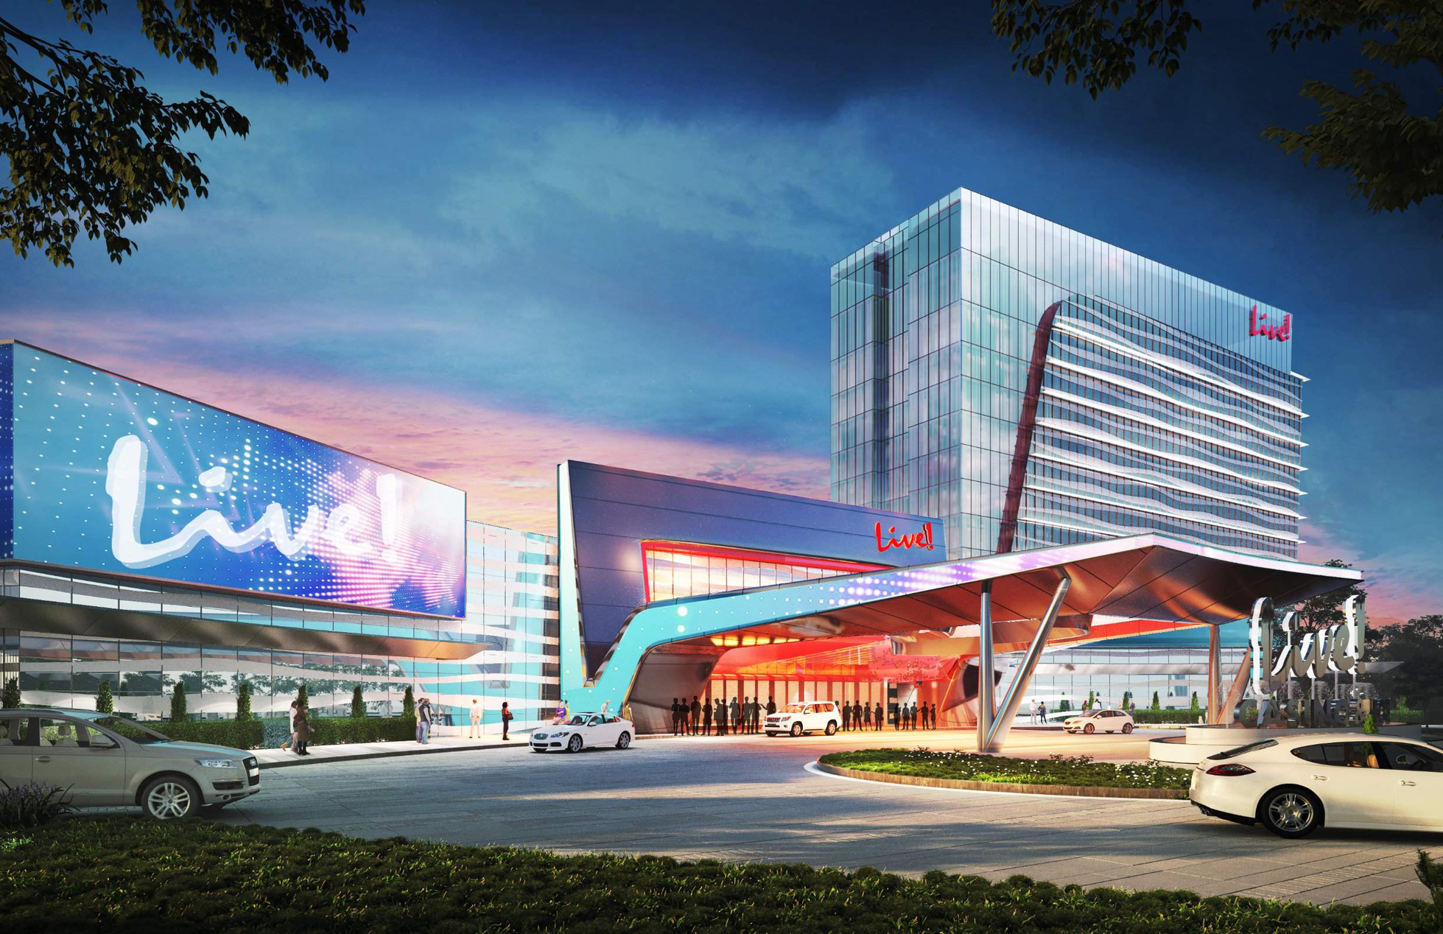




October 2025

Slide 2
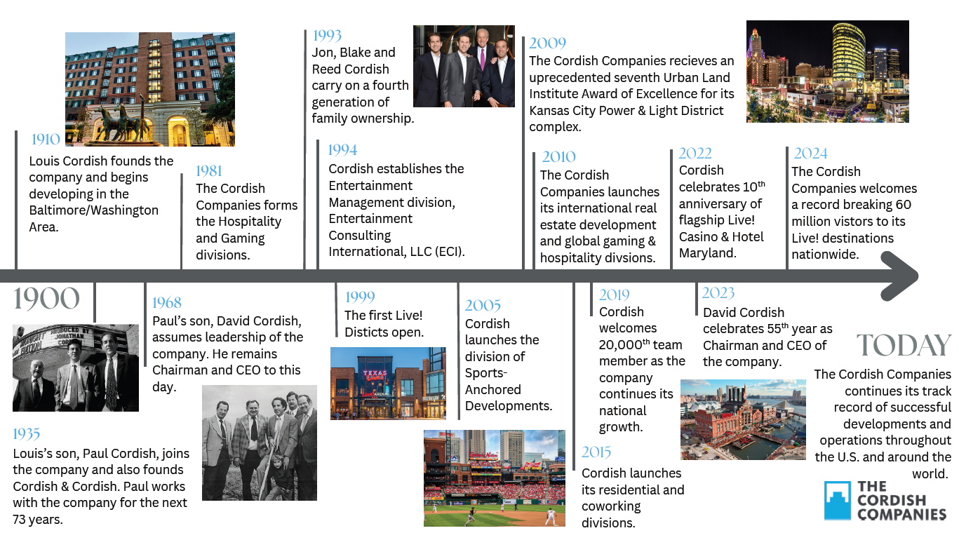
Notes:
120 year old family company

Slide 3
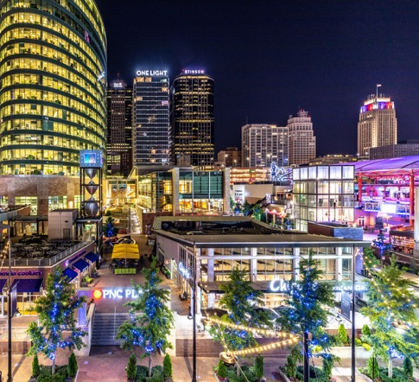

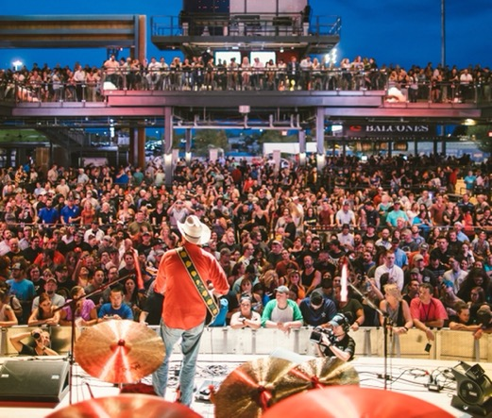
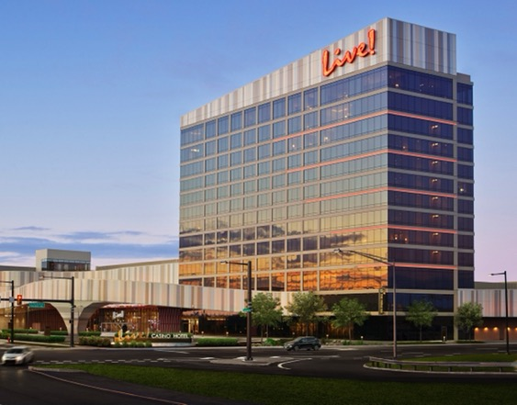
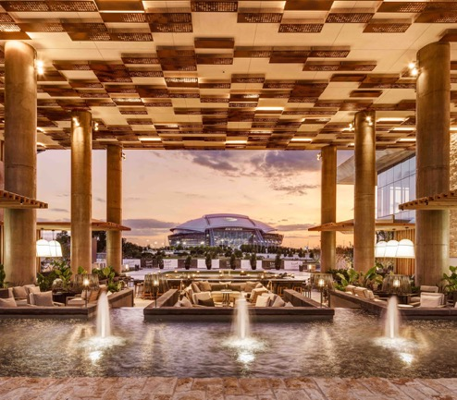

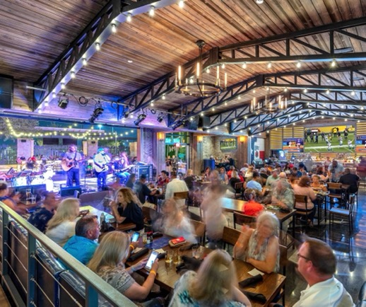
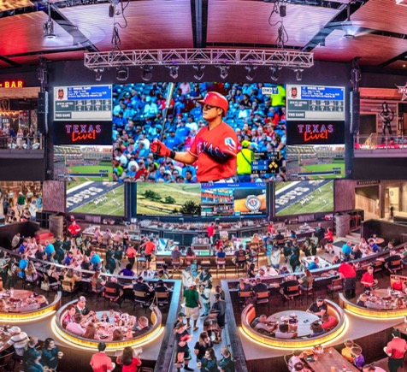
COMMERCIAL
REAL ESTATE
COWORKING
SPACES
ENTERTAINMENT
DISTRICTS
GAMING
We pride ourselves on the breadth and depth of our in-house expertise and capabilities in both project development and business operations. Unique from other developers, this allows us to not only build and manage, but to operate everything from entertainment venues and restaurants to world-class casino resorts, hotels, and luxury residential towers.
HOTELS
RESIDENTIAL
RESTAURANTS
SPORTS-ANCHORED
DISTRICTS
Notes:
We are developer at heart with focus on many verticals.

Slide 4

Notes:
Our Live Brand is our core hospitality brand and is growing exponentially

Slide 5
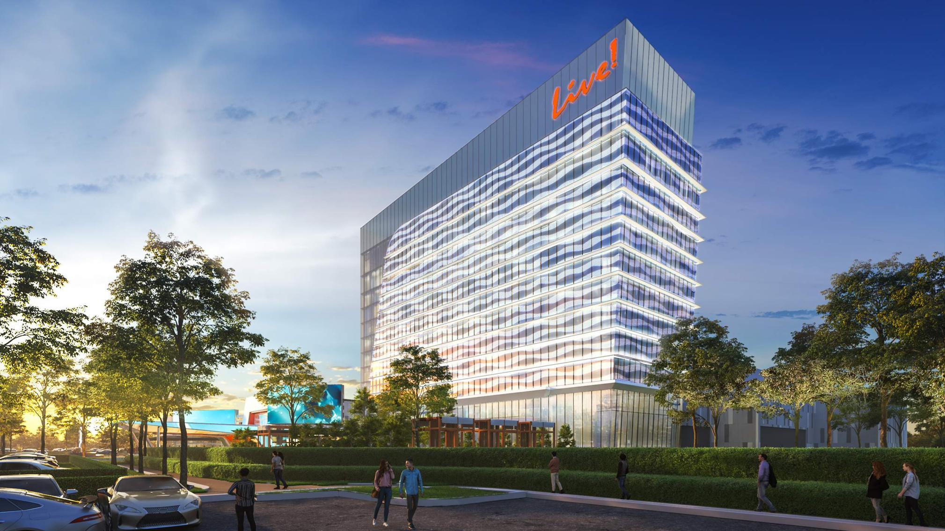
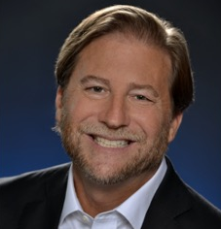
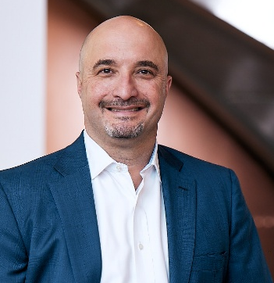

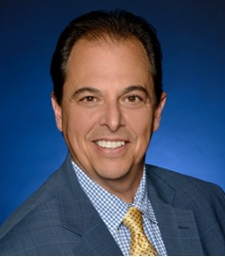
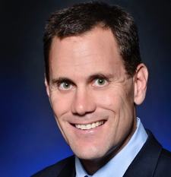

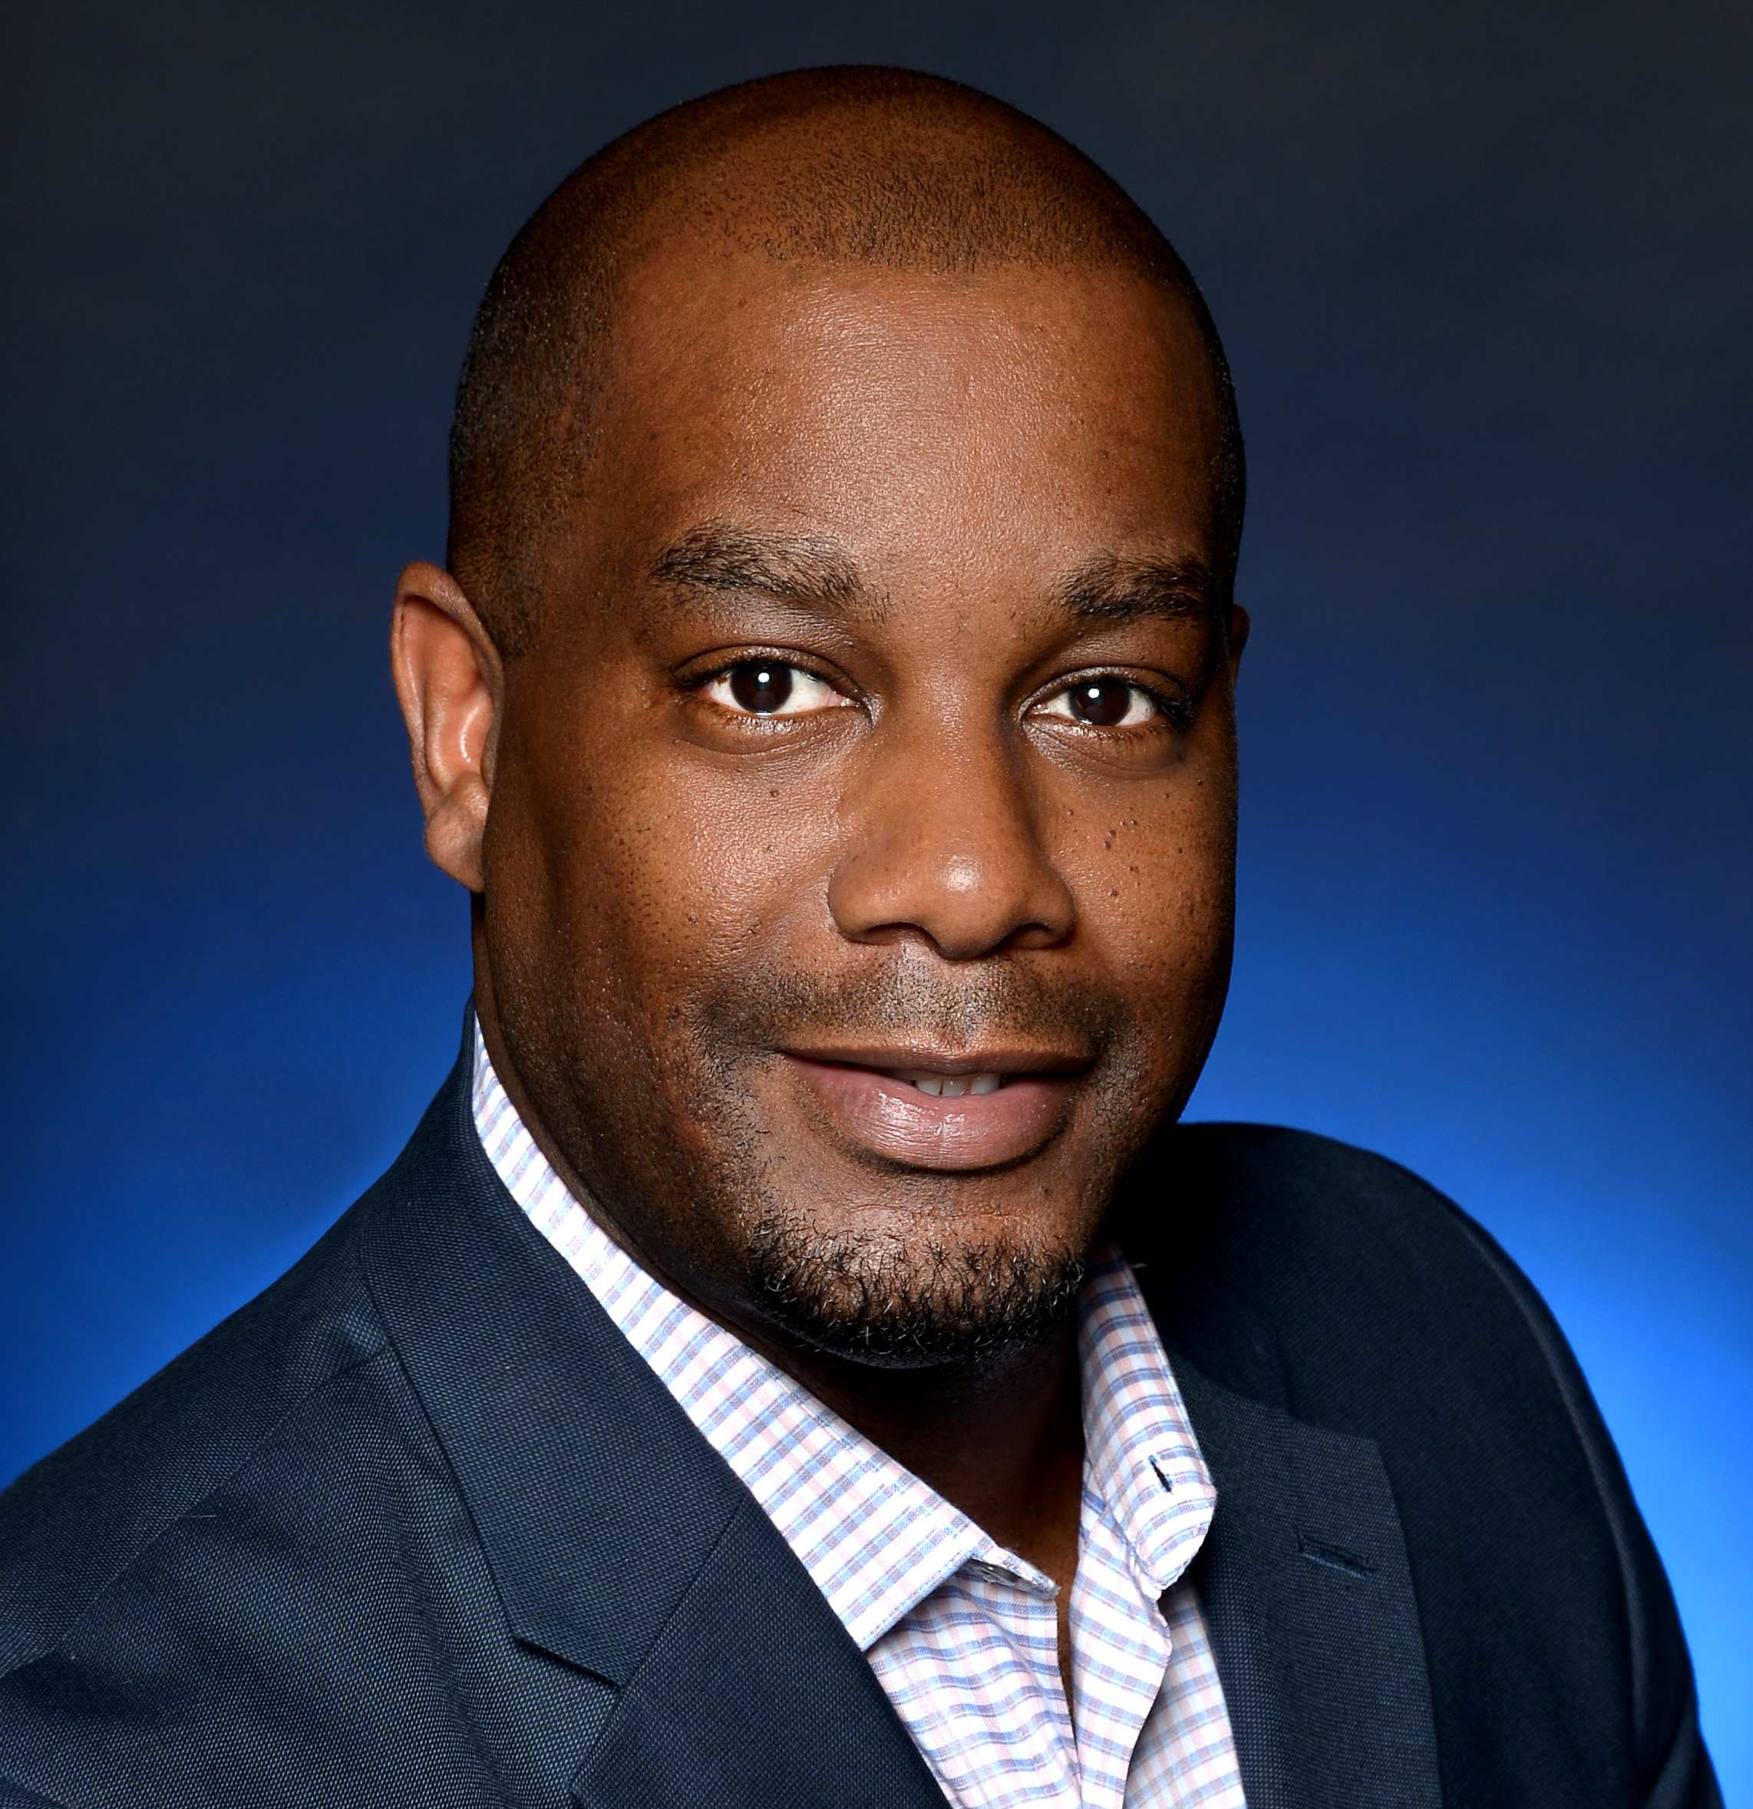
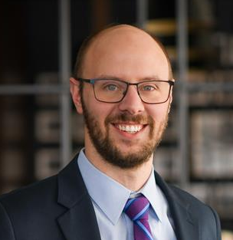
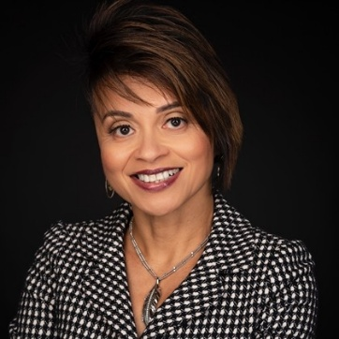


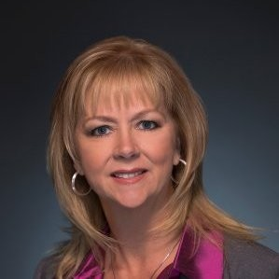
LEADERSHIP TEAM
JOSEPH WEINBERG
ROBERT J. NORTON
MARK STEWART
JOE BILLHIMER
Managing Director
President
EVP & General Counsel
EVP & Chief Operating &
Development Officer
TRAVIS G. LAMB
SUZANNE TROUT
EDWARD EVANS
KEITH HUDOLIN
EVP & CFO
EVP CMO
Director of Social Responsibility
EVP & General Counsel
PENNY PARAYO
YANINA DE VARGAS
CHERYL BROWN
TRISH TUCK
SVP of Operations & GM- VA
SVP & CFO - VA
VP of Marketing - VA
VP of Human Resources - VA
Notes:
Introduce Penny and the VA leadership team.

Slide 6
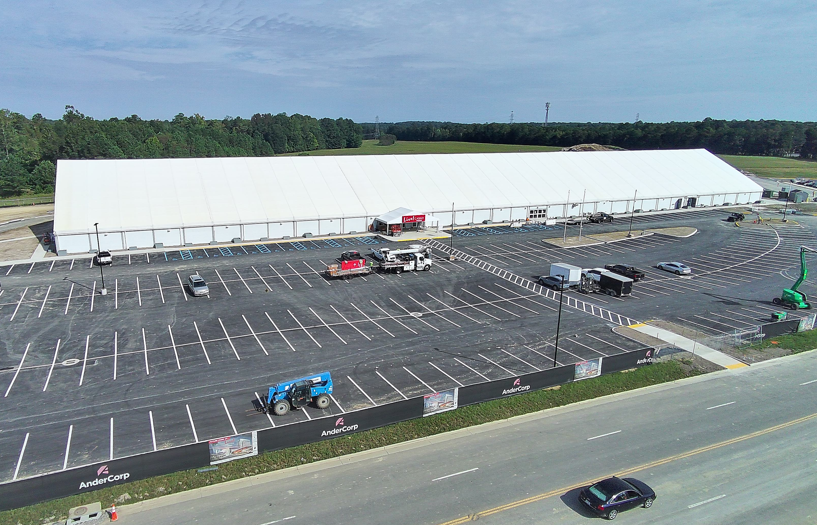
PROJECT UPDATE
Temporary Casino

Slide 7
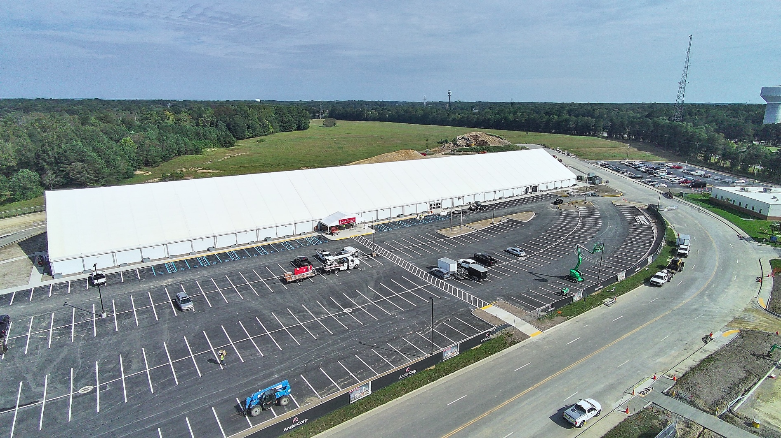
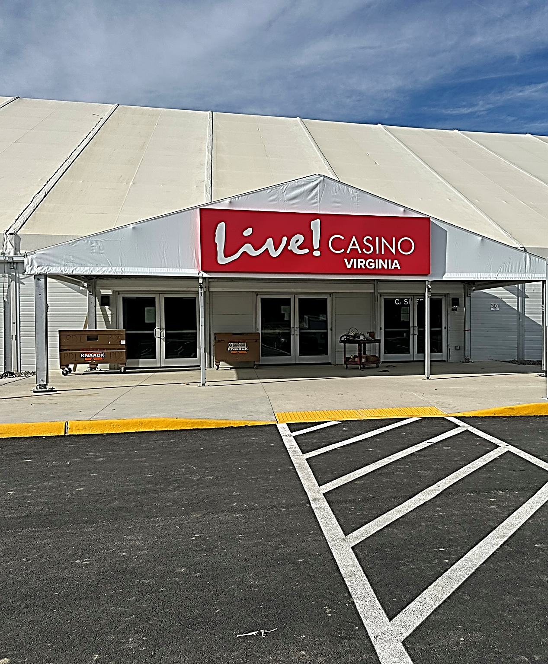
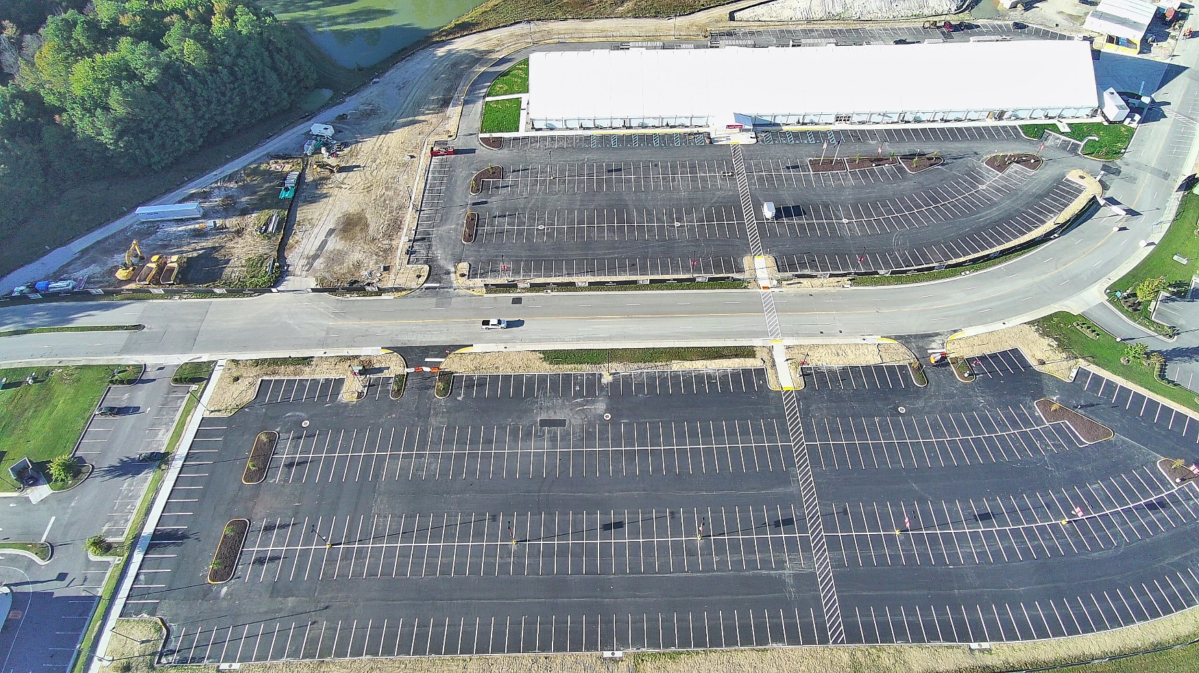
TEMPORARY GAMING FACILITY
75,000 sq. ft Gaming Space
900+ Slots
30+ Table Games
Casino Bar
Quick Service Restaurant

Slide 8
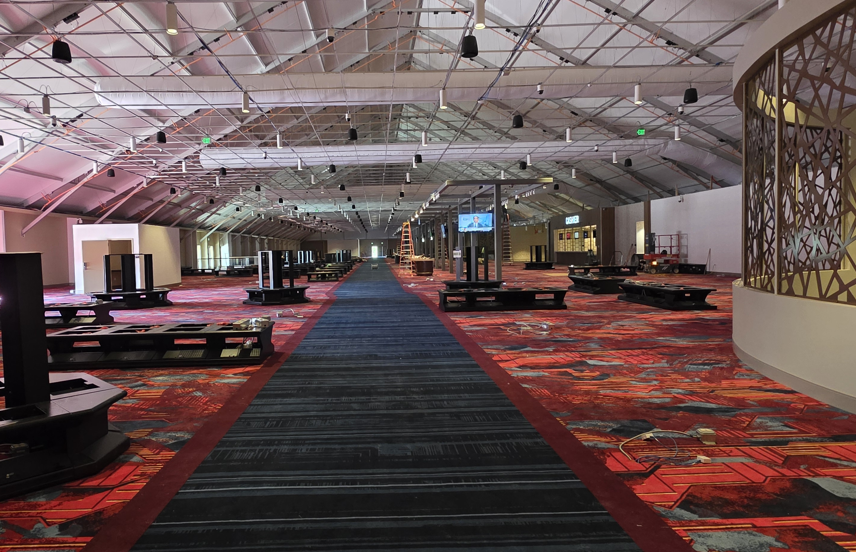

Slide 9
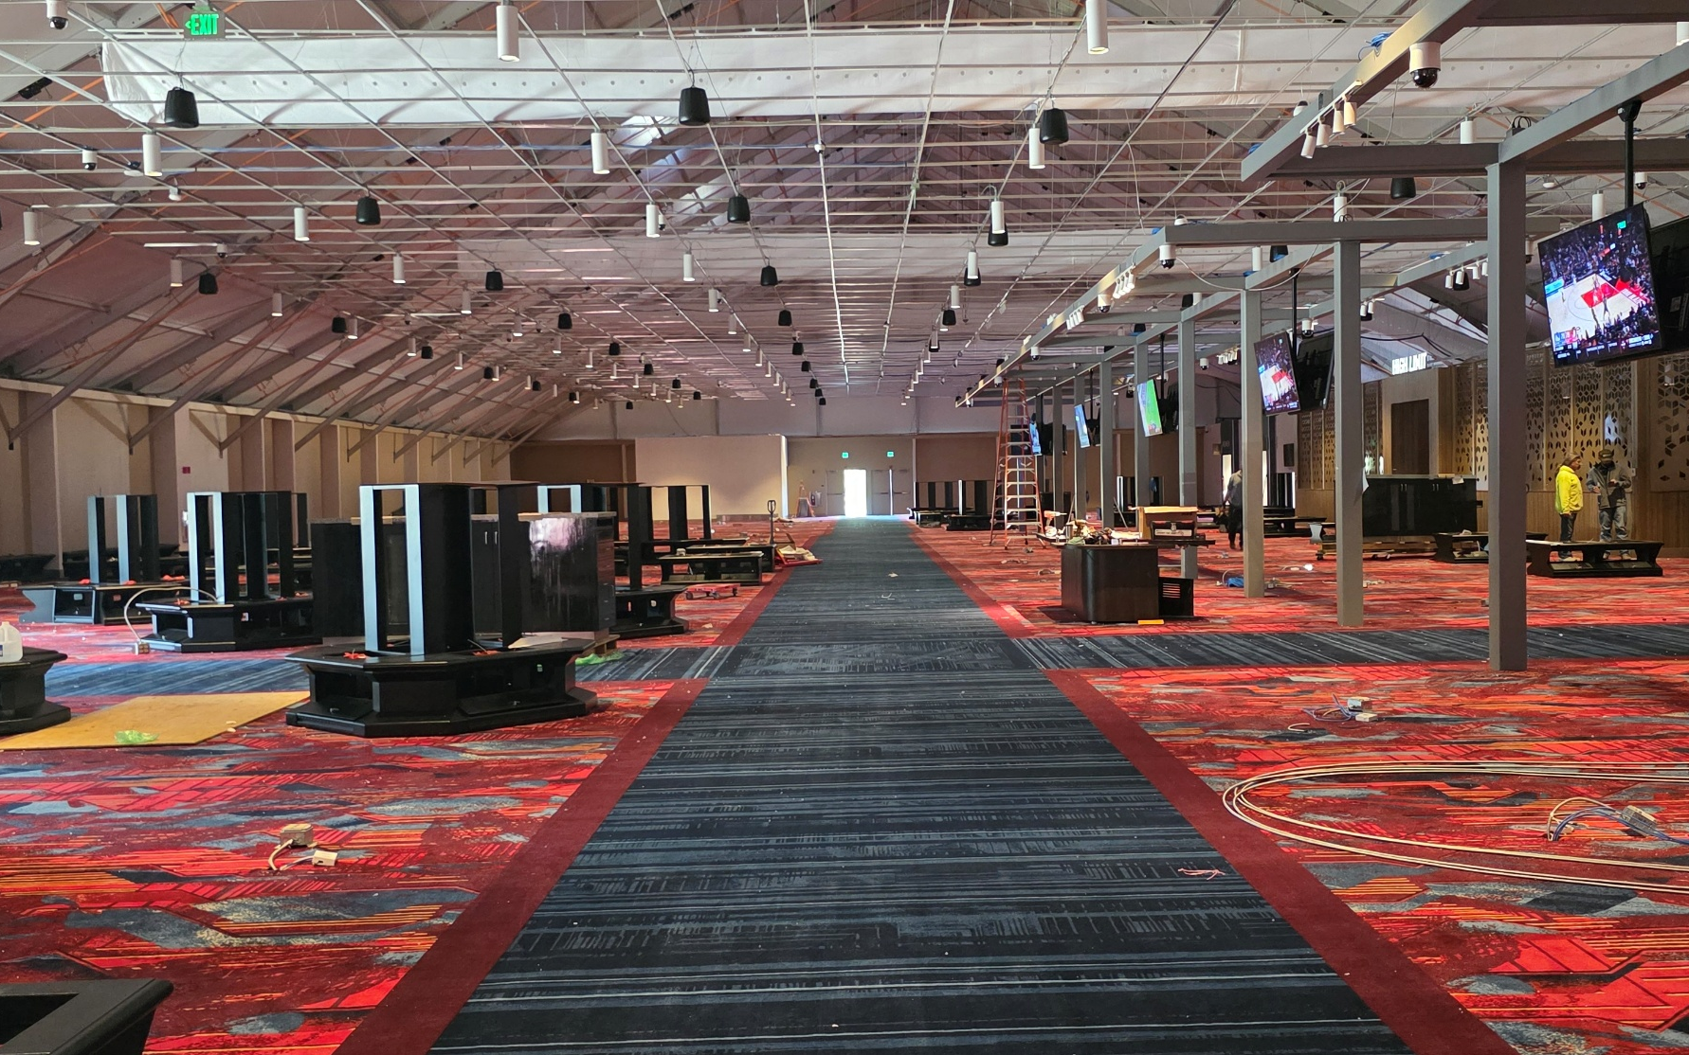
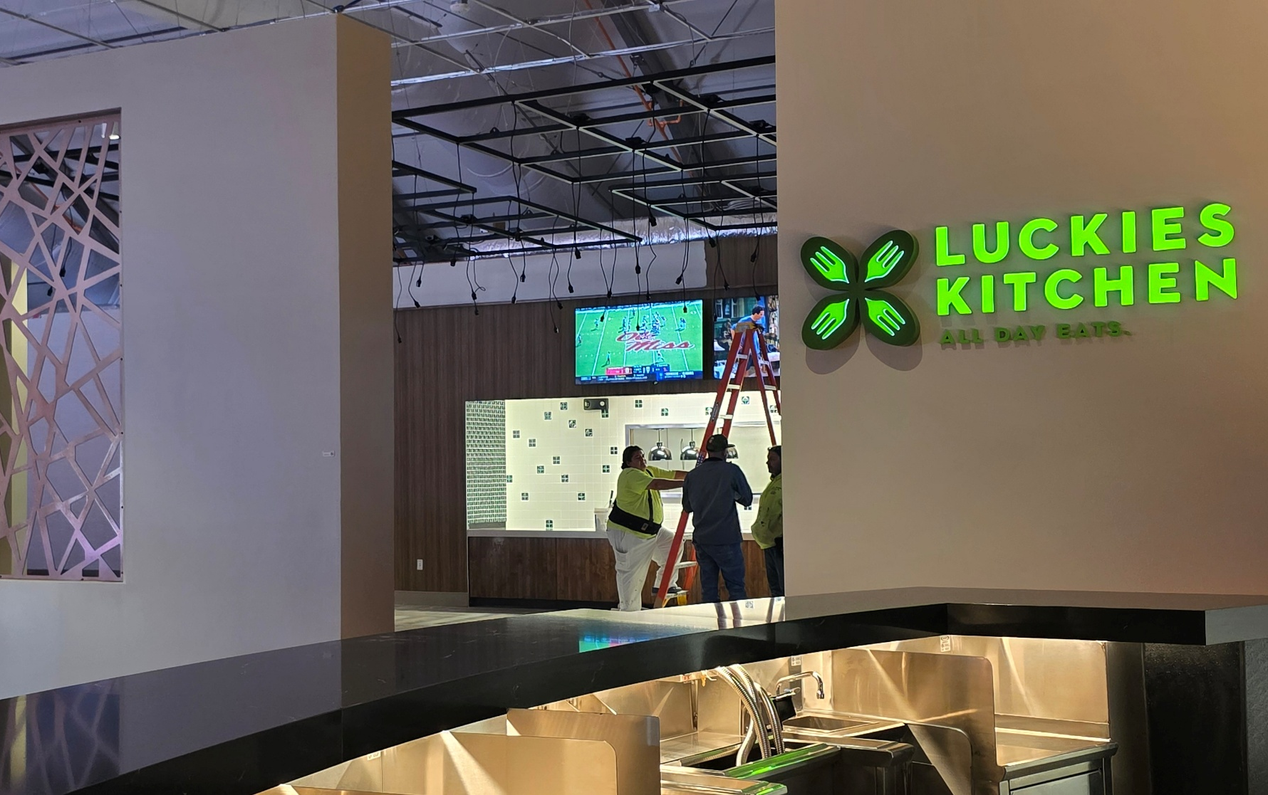
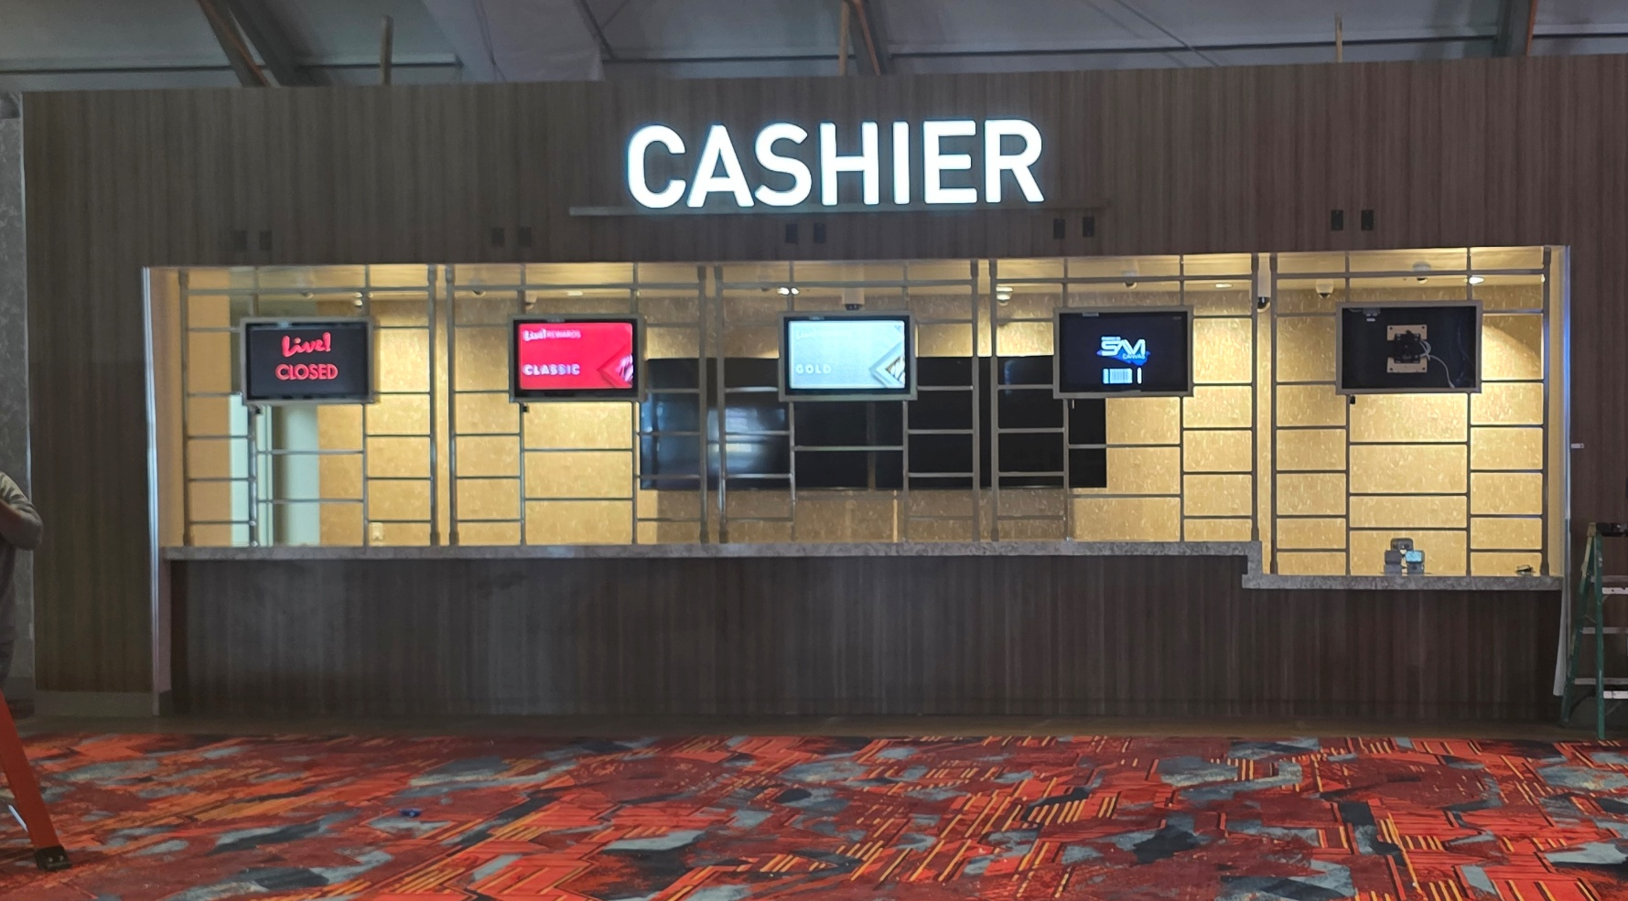


Slide 10
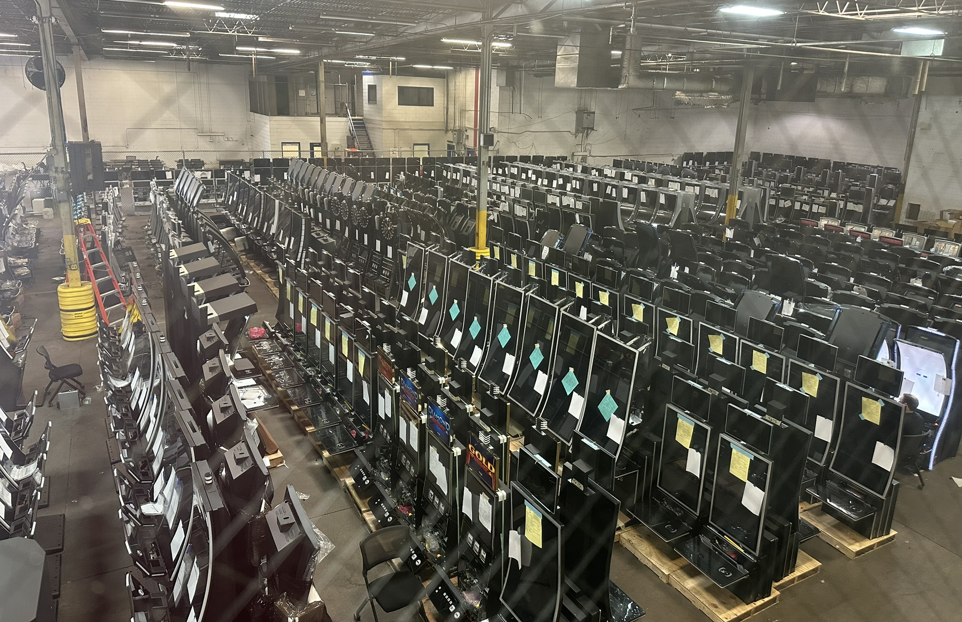

Slide 11
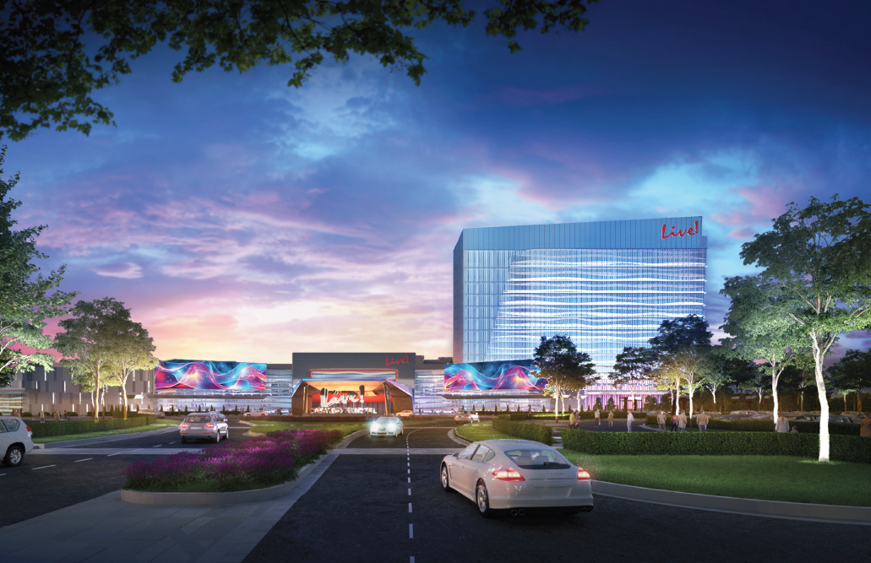
PROJECT UPDATE
Permanent Casino

Slide 12
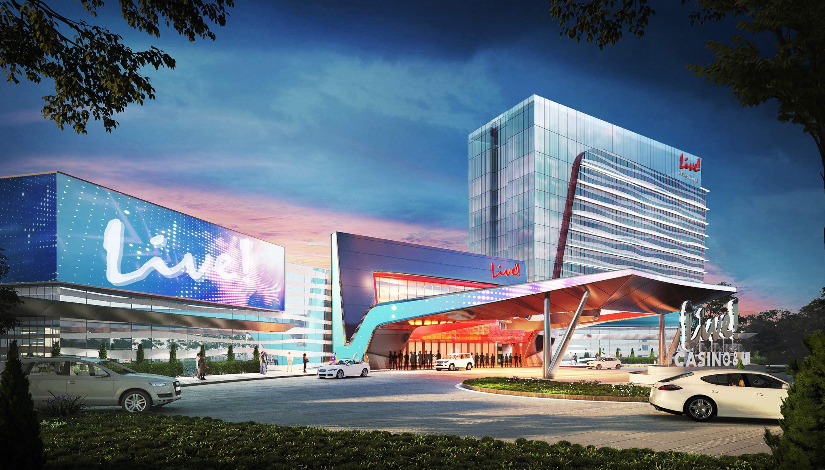

Slide 14
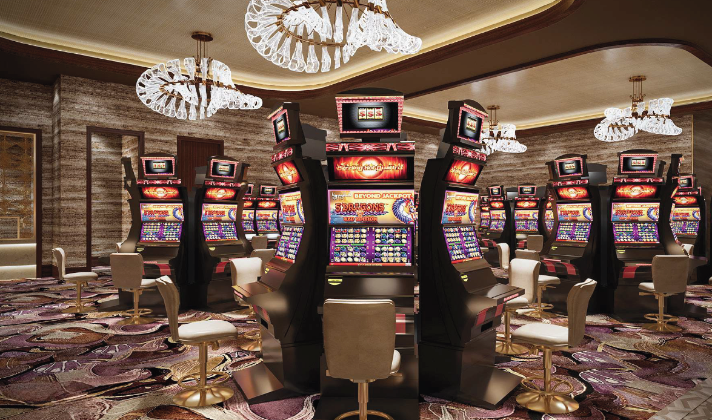
CASINO

Slide 15
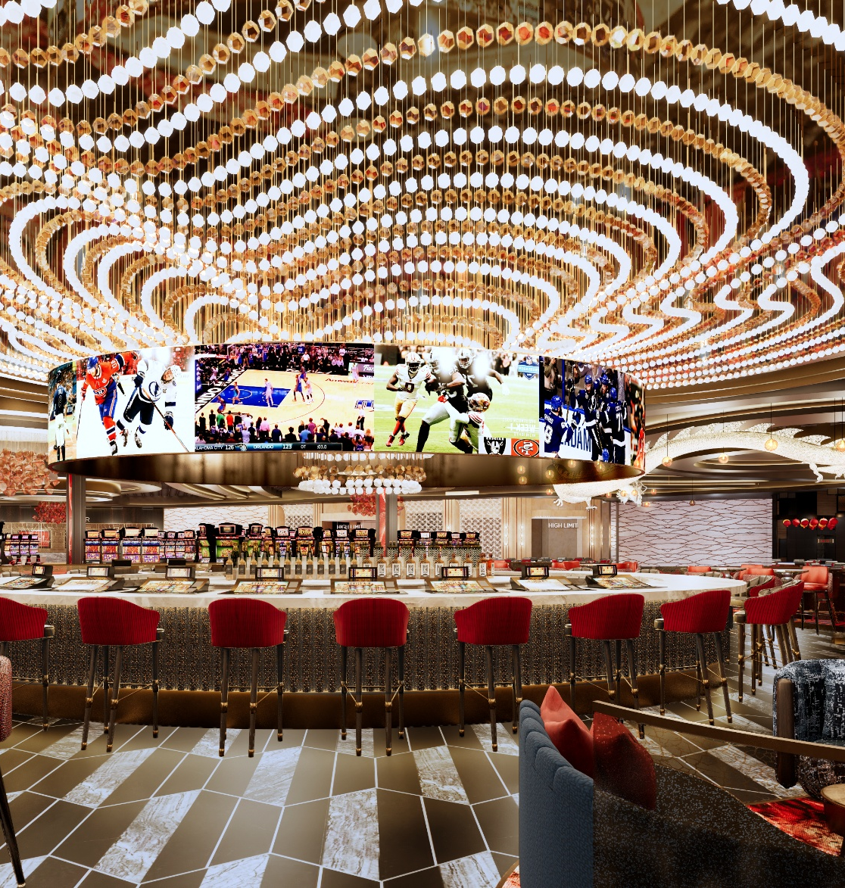
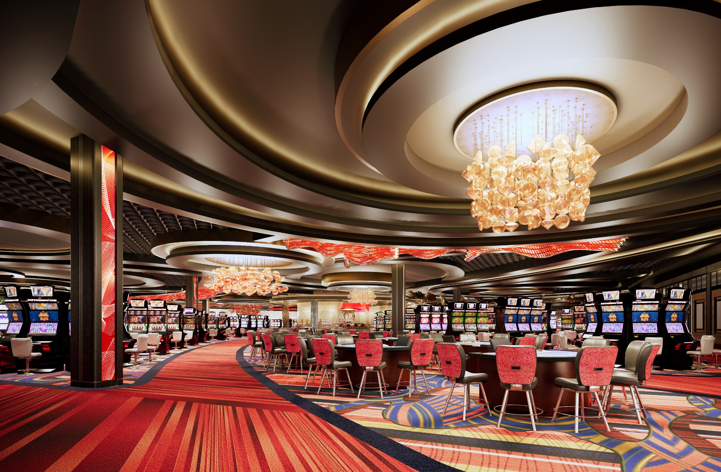


Slide 16
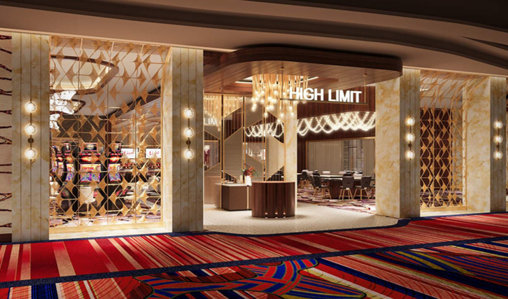
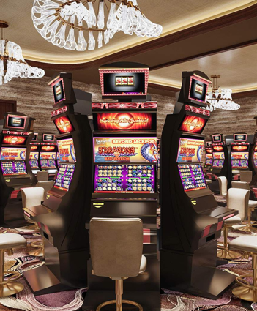
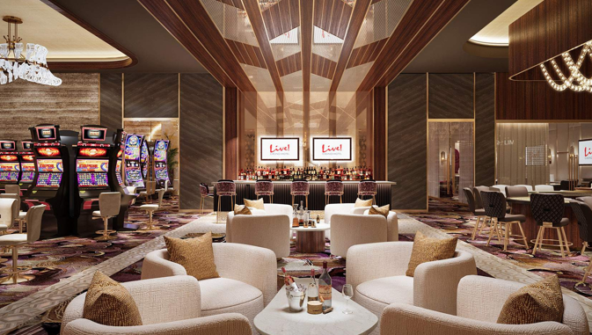

Slide 17
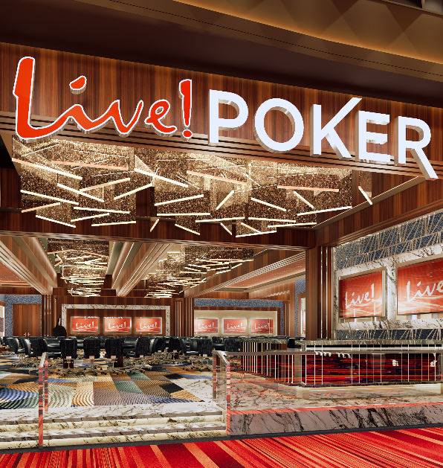
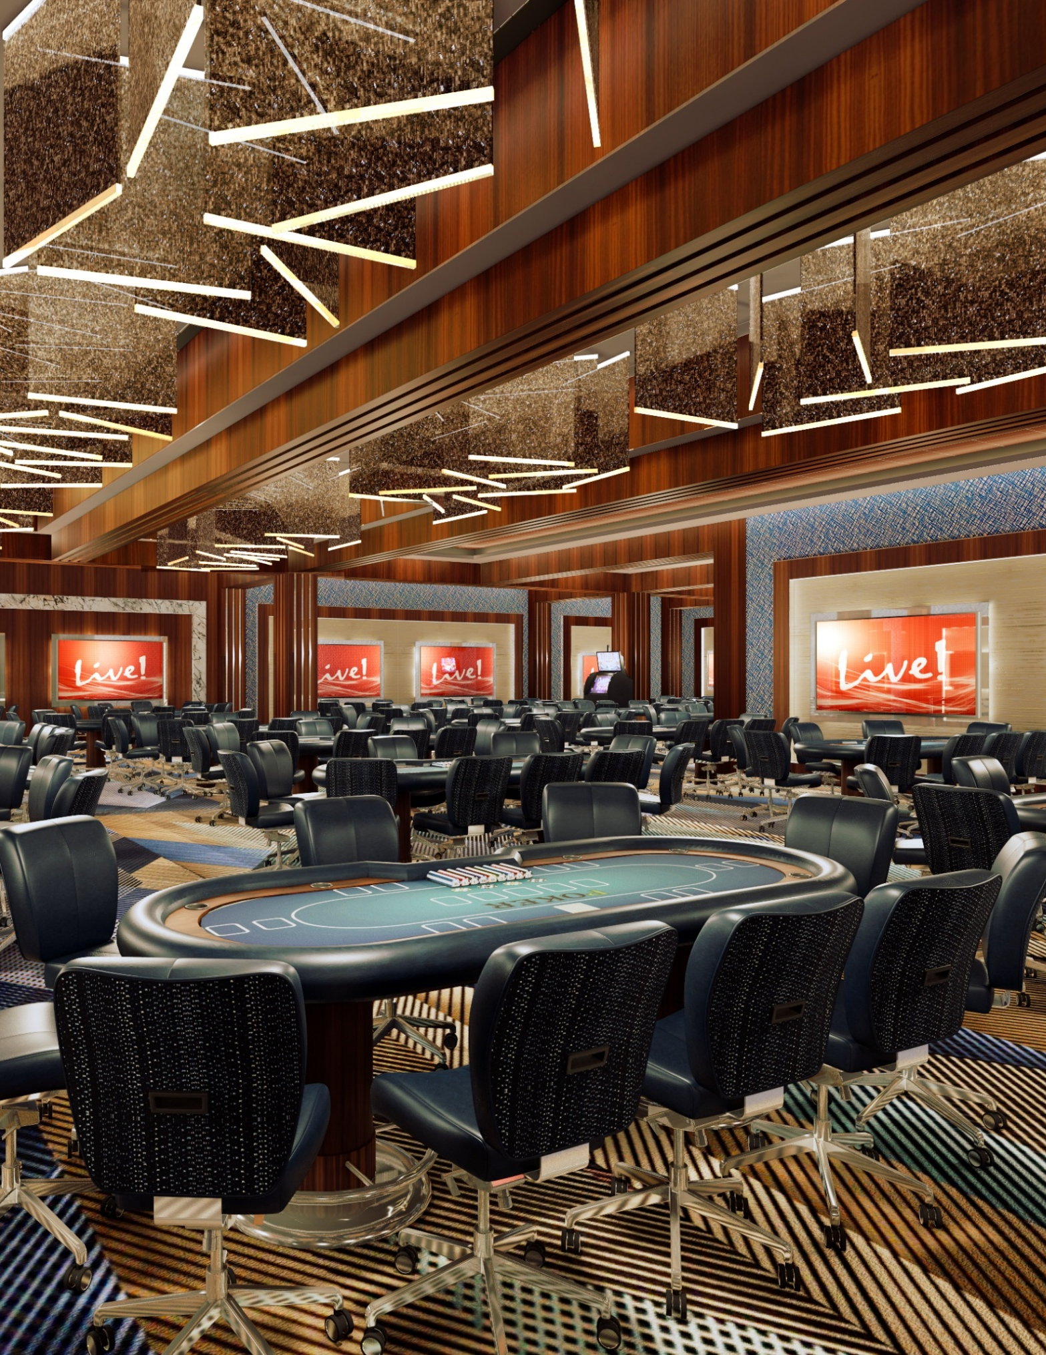

Slide 18

FOOD & BEVERAGE

Slide 19
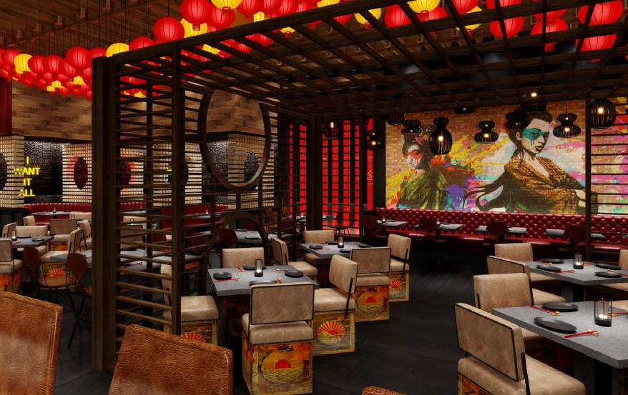
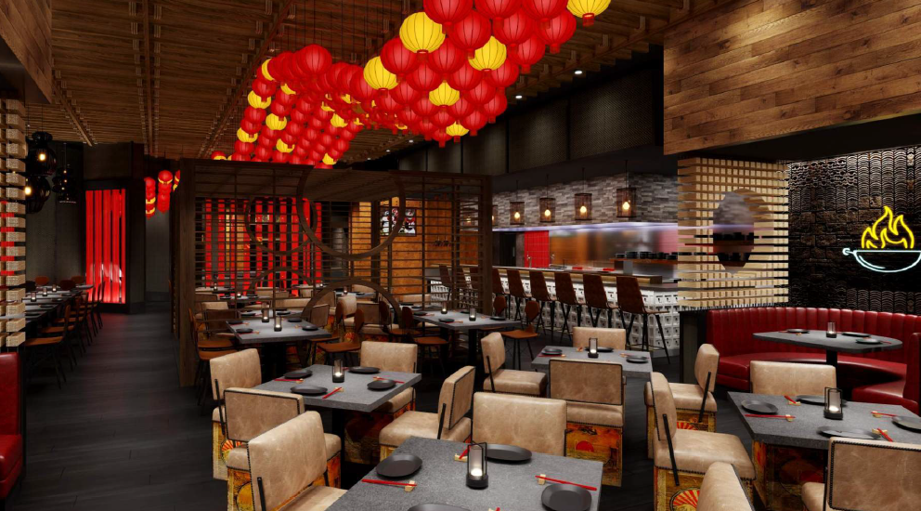

Slide 20
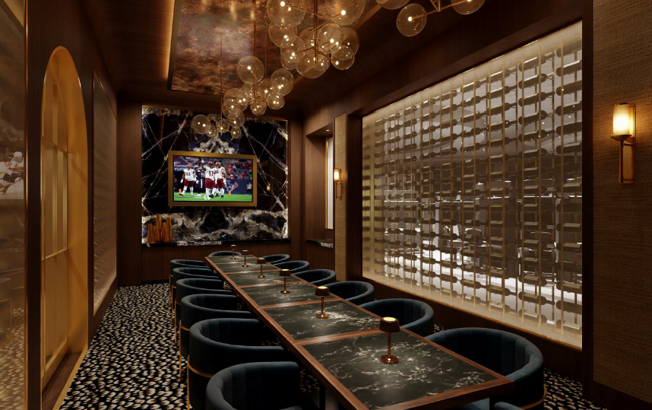


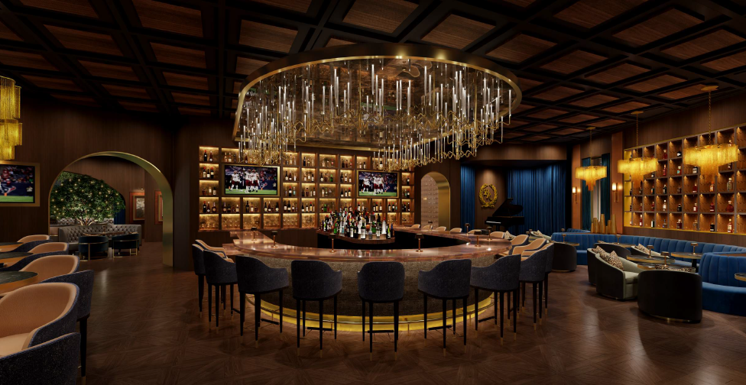

Slide 21

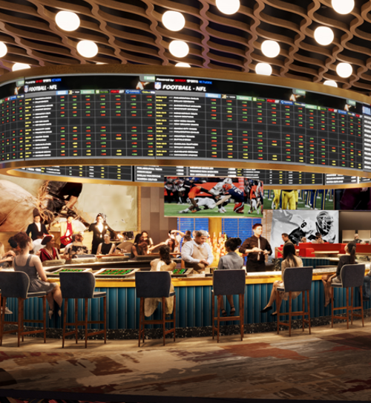
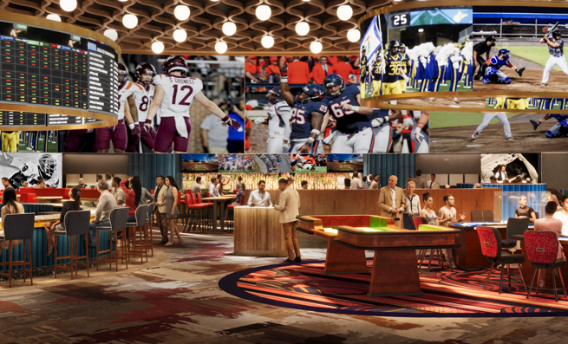

Slide 22

HOTEL & MEETING

Slide 23

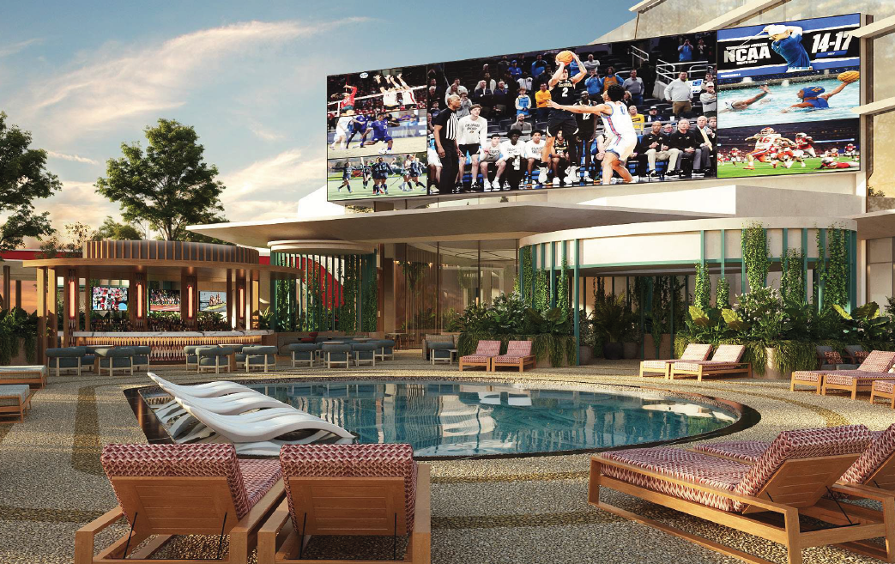
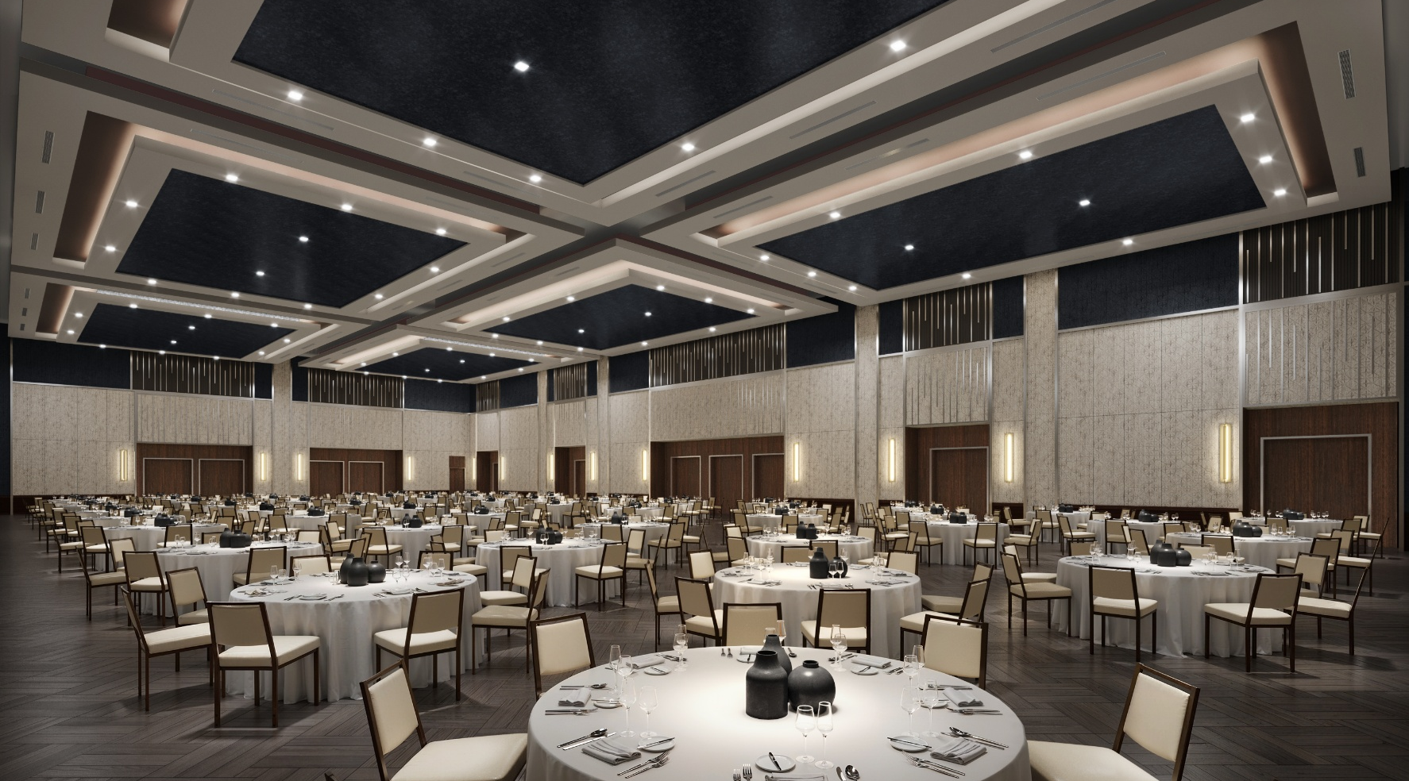

Slide 24




Slide 25
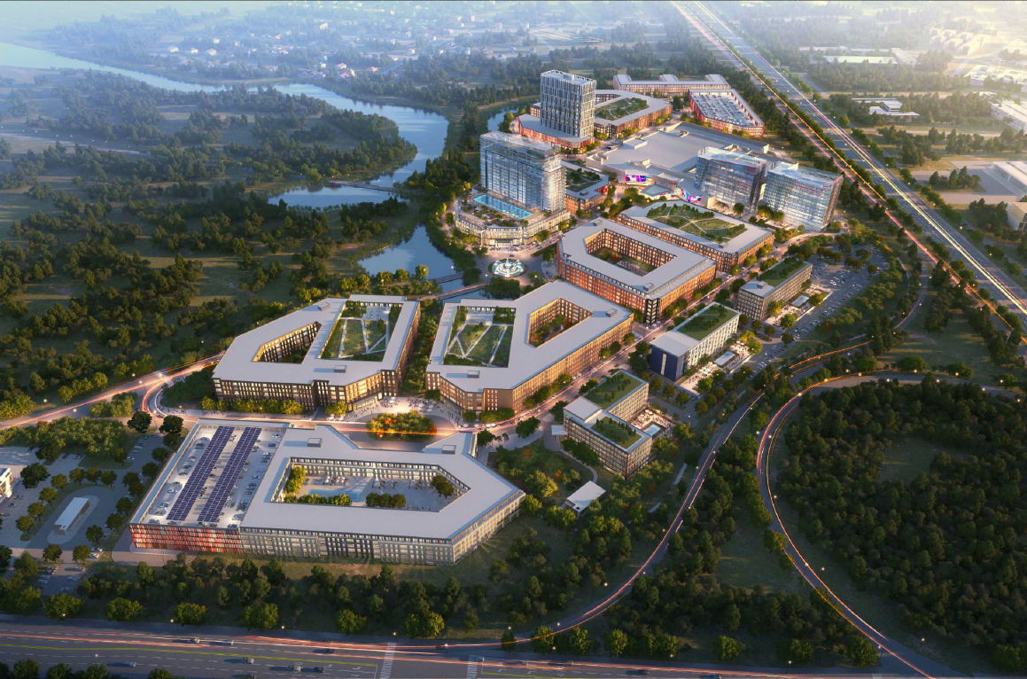
MASTER PLAN

Slide 26
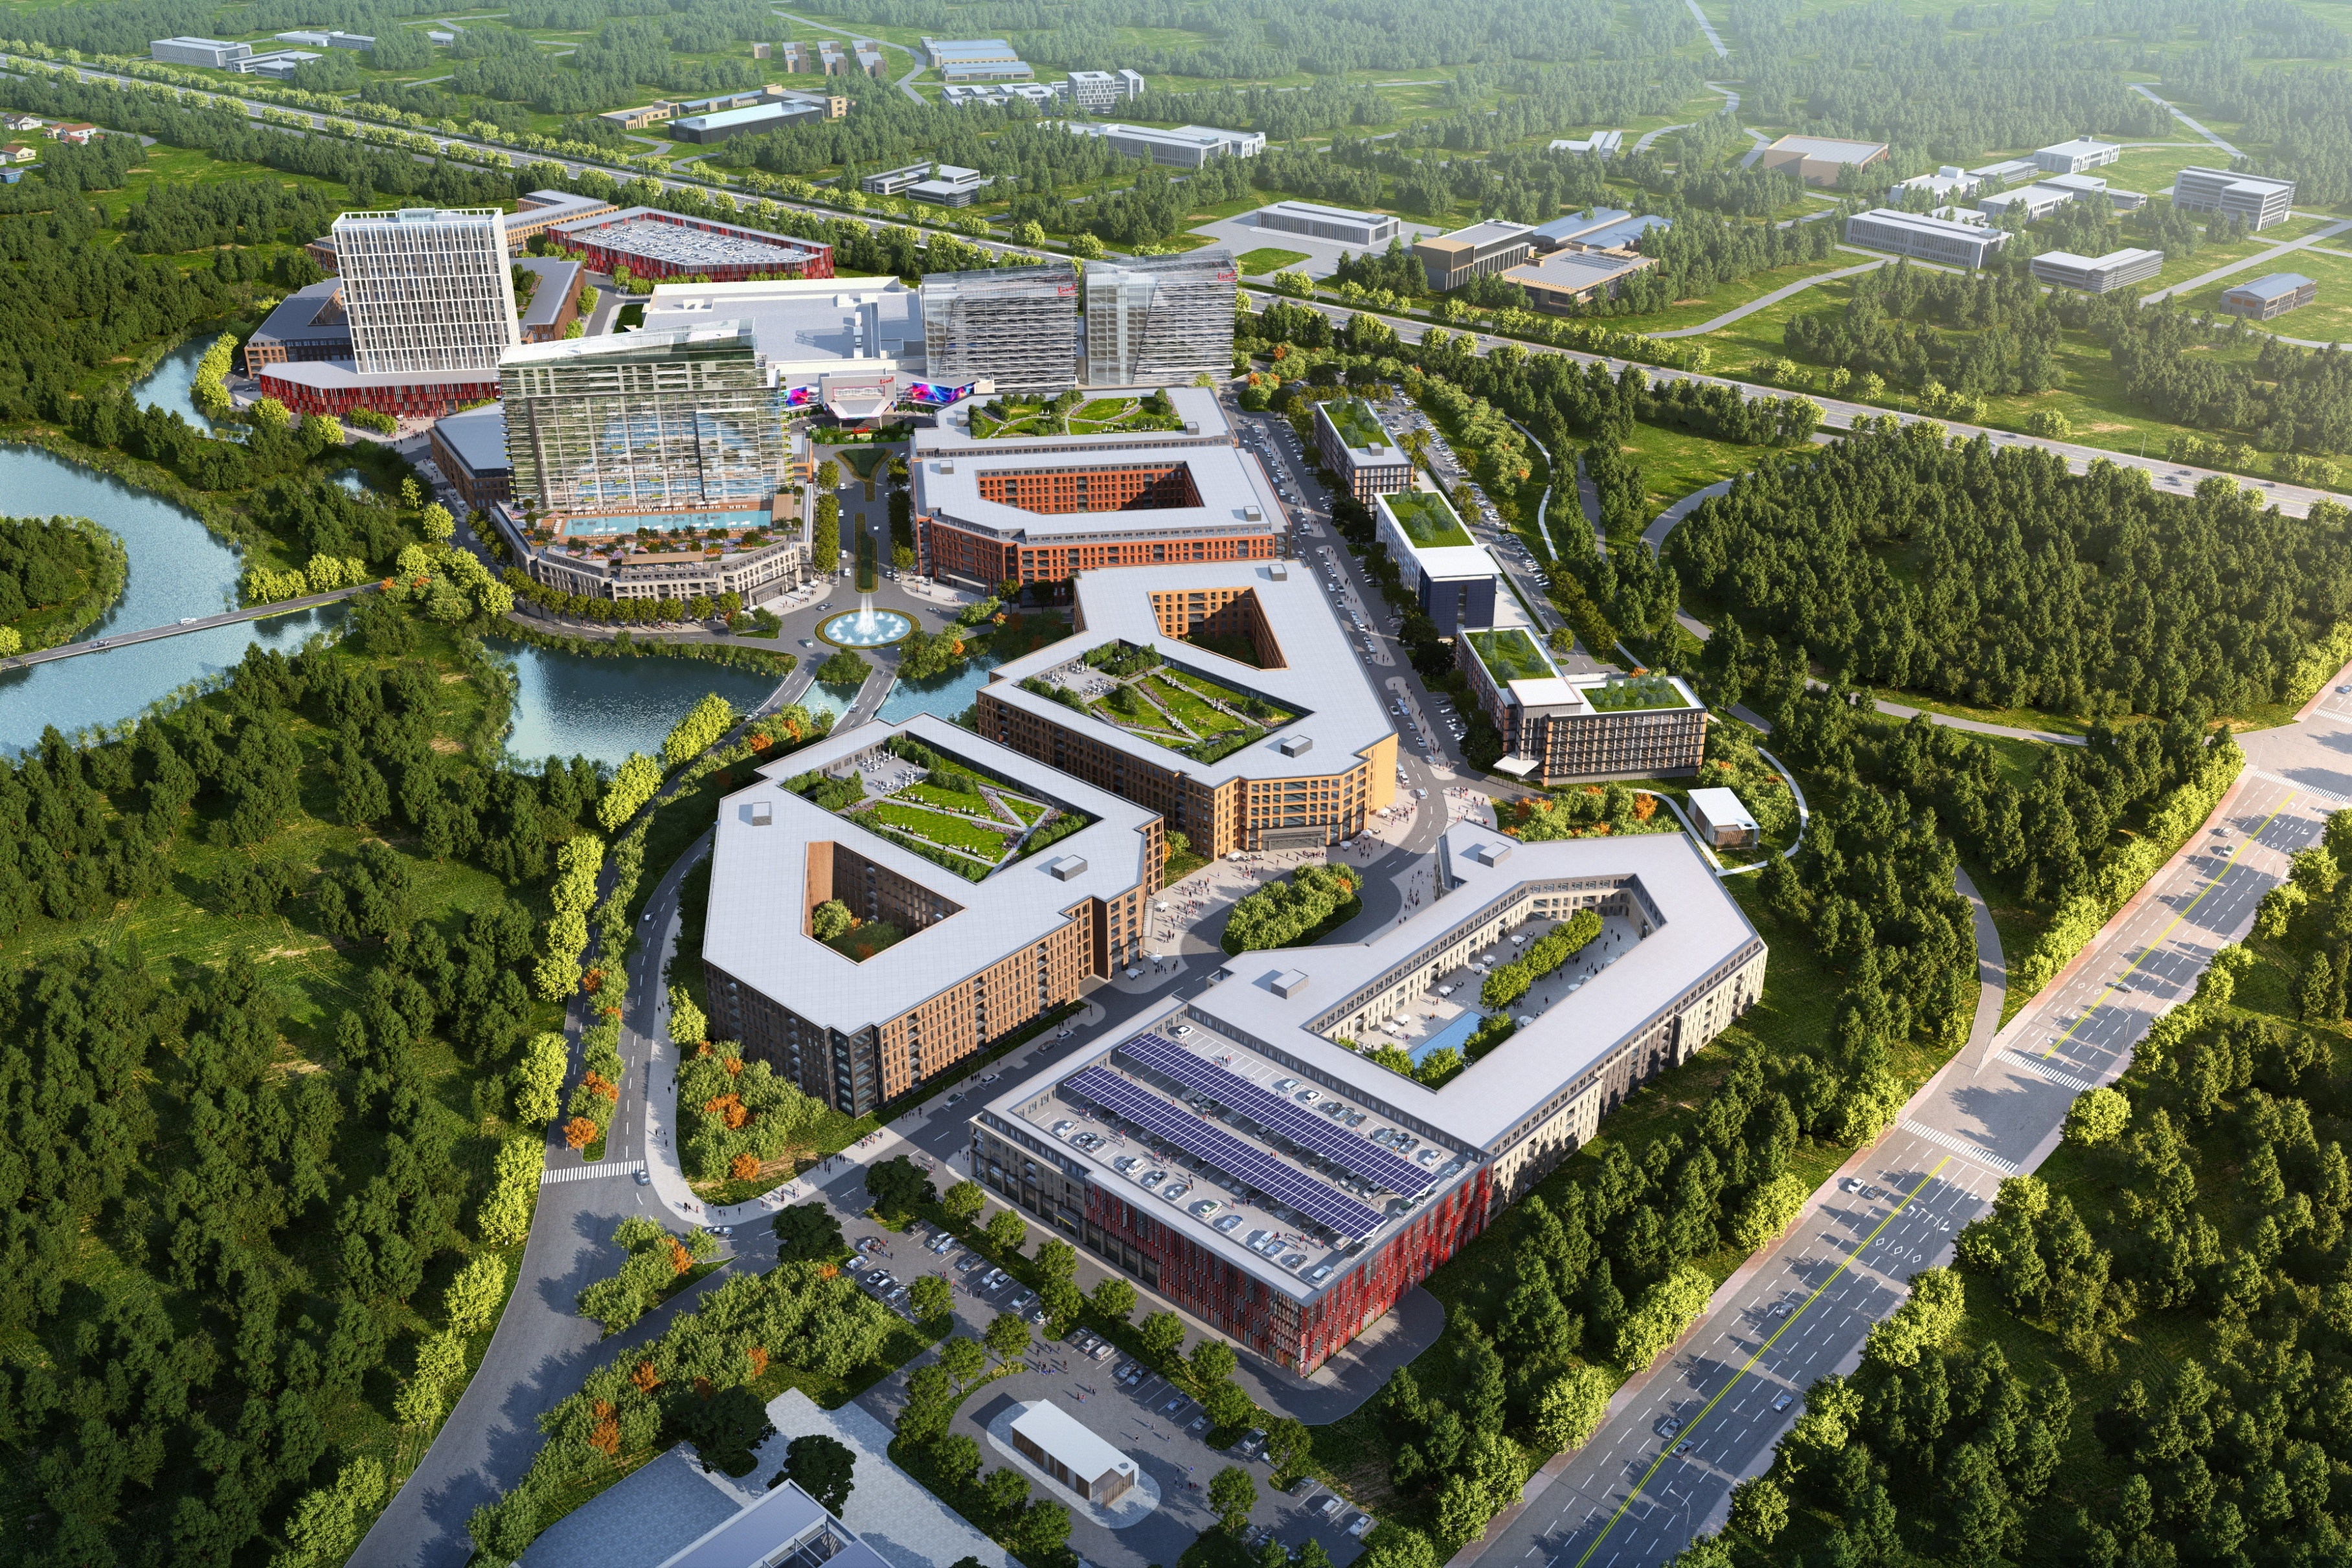

Slide 27


Slide 28
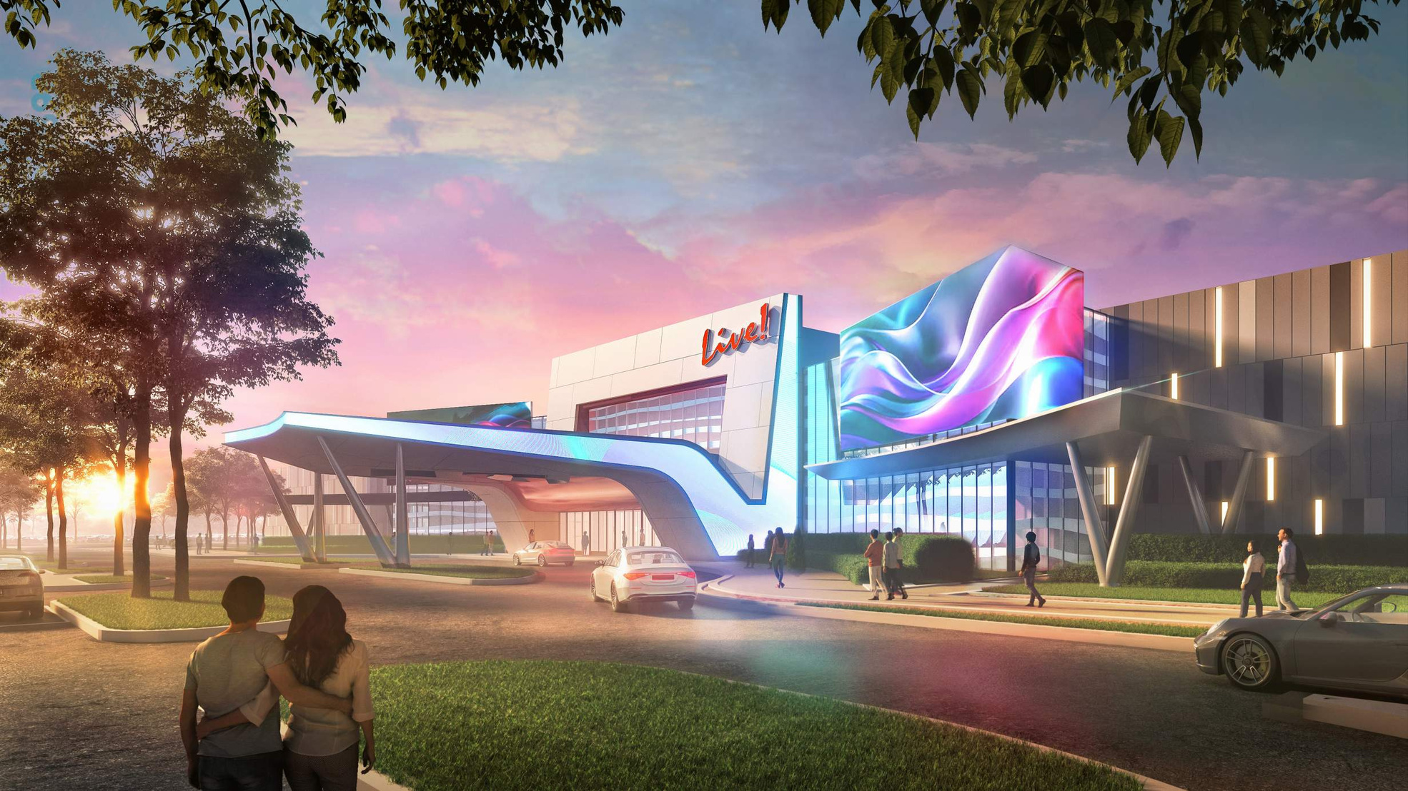
ECONOMIC IMPACT

Slide 29
INCREMENTAL REVENUE TO CITY OF PETERSBURG
Temporary casino will expedite revenue to the City of Petersburg
$243 Million in First 10 Years to City of Petersburg
Averaging $24 Million Per Year (17% of 2025-2026 City Budget)
Notes:
Temp operations accelerates financial benefits and jobs
Operations and Construction for Temp: State ≈$153.4M: City≈$136.4 M to the city.

Slide 30
FUTURE ECONOMIC IMPACT
In its first 10 years, Live! Casino & Hotel Virginia will generate…
$2.8 billion in economic stimulus to the region​
$240 million to the City of Petersburg​
$802 million in economic benefits during construction​
$201 million in annual economic benefits after opening​
6,100 construction jobs during the construction phase​
1,400 new permanent jobs (500 during temporary operations)

Slide 31



PROPOSED TIMELINE
Opening Temporary
Referendum
Design & Construction of Temporary
Training
Opening Permanent
Construction of Permanent
Design of Permanent
Training
2024
2025
2026
2027
License Submission
Dealer School
Lottery License Approval
Recruitment Center Opens
ICs Submitted
Notes:
Review timing and all this is at risk.

Slide 32

iGAMBLING

Slide 33
iGambling – Not Your Father’s Slot Machine
“. . .Gambling today is fundamentally different from every other form of gambling in recorded human history. In the last few years, limitless, frictionless gambling has become available to anyone with an internet connection. What once required a trip to the bank and casino can now be done on an app – from home or from school, at all hours of the day.”
Smartphone Gambling is a Disaster Jonathan D. Cohen and Isaac Rose-Berman (July 24, 2025)

Slide 34
iGambling – Not Your Father’s Slot Machine
DIFFERENT DEVICE 205x/day – every 5 minutes – that’s how often Americans check their smartphones each day.
DIFFERENT GAMES “Beyond easier access, much of the increase in online gambling is due to the fact that gambling companies have engineered their games to be ever more difficult to resist.”
Cell Phone Usage Stats 2025: Americans Check Their Phones 205 Times a Day, Trevor Wheelwright (January 1, 2025)
Smartphone Gambling is a Disaster, Jonathan D. Cohen and Isaac Rose-Berman (July 24, 2025)

Slide 35
Public Health Crisis
Stewart Kenny, co-founder of Paddy Power – a major online operator which now owns FanDuel – on iGambling:
“The industry is going to change dramatically in the next three to five years. It’s going to go from being an entertainment business to an addiction business.”
Britain opened the door to online gambling. Now it’s living with the consequences, Bloomberg News (December 4, 2022)

Slide 36
Public Health Crisis
ONLINE GAMBLING HAS LED TO A UNIVERSAL AND DRAMATIC INCREASE IN PROBLEM GAMBLING AND HELPLINE CALLS:
320% increase in Pennsylvania helpline calls
NPG Helpline Call Data increase in average calls pre and post iGaming
277% increase in New Jersey helpline calls
NJ Spotlight News Surge in problem gambling in NJ — and in calls for help (September 26, 2024)
30% increase in risk of gambling addiction
National Problem Gambling Council
378% increase in West Virginia helpline calls
NPG Helpline Call Data increase in average calls pre and post iGaming
267% increase in Michigan helpline calls
ABC12.com Revenue and addiction skyrocket in 5 years since law legalizing online gambling (November 19, 2024)
Nearly 20% of 18–24-year-olds in New Jersey have a gambling problem
Nower, L., Stanmyre, J.F. & Anthony, V. (2023). The Prevalence of Online and Land-Based Gambling in New Jersey. Report to the New Jersey Division of Gaming Enforcement.
“A lot of [the 277% increase] has to do with easy accessibility for people to place wagers via their phone.”
Felicia Grondin, Surge in problem gambling in NJ — and in calls for help (September 26, 2024)

Slide 37
iGambling – Fool’s Gold
Why should Virginia consider putting a casino on every cell phone in the state?
iGambling is illegal in 43 states
Rejected by states more than 21x in the last two years
Promised easy tax revenue is a mirage
Social costs are real and are severe
iGambling’s fundamental premise is to increase profits through dramatic reductions in employment and investment

Slide 38
NET TAX REVENUE? . . . A MIRAGE
The financial portion of the iGambling debate centers around its true net tax revenue impact. States need to consider the complete picture:
promised iGambling tax revenue
minus cannibalized in-person gaming tax revenue
minus less in-person hotel, restaurant and entertainment tax revenue
minus cost of job losses & economic ripple effects
minus cost of increased addiction & social/mental health problems
= true net of iGambling
This calculation shows the true net impact of iGambling is minimal to negative for the state – and not worth the risks and harm

Slide 39
iGambling’s Rippling Harms
Severe job losses – nearly 3,700 PA casinos workers at casinos open before iGambling’s launch lost their jobs – a 26% decline in casino workforce
Organized labor is strongly opposed – in MI, 38% of Unite HERE’s members lost their jobs since iGambling launched
Small businesses and suppliers to casinos lose substantial revenue – costing state and local governments non-gaming tax revenue
Host communities lose vital sources of funding
States lose GDP and Economic Output

Slide 40
Virginia’s Keys to Success
The most successful gaming states in America have been cautious and promoted stability
A stable, carefully-crafted market maximizes job growth and tax revenue
Stability is key to reinvestment and economic development
Virginia still has unopened casinos and its regulatory framework is evolving
Virginia should take a strategic pause and avoid the pitfalls of out-of-control expansion

Slide 41


THANK YOU

