Slide 1

Retail Tobacco Permitting

Slide 2
OVERVIEW
Brief History
What is considered a “Retail Tobacco Product?”
Timeline for permit applications.
VAABC efforts around enforcement.
VAABC role in the process.

Slide 3
Historical Context
Office of the Attorney General
Virginia Department of Taxation
HB308/SB620 and Virginia ABC

Slide 4
Retail Tobacco Products
…means (i) any product containing, made of, or derived from tobacco or that contains nicotine that is intended for human consumption or is likely to be consumed, whether smoked, heated, chewed, dissolved, inhaled, absorbed, or ingested by other means, including a cigarette, heated tobacco product, chewing tobacco, snuff, or snus;
(ii) any electronic smoking device and any substances that may be aerosolized or vaporized by such device, whether or not the substance contains nicotine; and
(iii) any component, part, or accessory of a product described in clause (i) or (ii), whether or not such component, part, or accessory contains tobacco or nicotine, including blunt or hemp wraps, and glass pipes.
"Retail tobacco product" does not include any cigar or pipe tobacco as defined in § 58.1-1021.01.
Notes:
Again from 4.1-100 as of October 1, 2026 –
Romanette 1 is pretty straightforward – this is what we have always traditionally considered to be tobacco products
Romanette 2 defines ANY electronic smoking device and any substances that can be aerosolized or vaporized regardless of nicotine content
Romanette 3 expands to include non-electronic smoking parts and accessories

Slide 5
Permit Requirements
Retail tobacco permits will be required on October 1, 2026.
Separate permit required for each location.
Good for 12 months, renewable.
There is a one-time, non-refundable permit application fee:
For retailers with an existing ABC license, the fee is $300.
For all other retailers (without a license to sell alcohol) the fee is $400.

Slide 6
Training Requirement
§59.1-293.13 - Any retail dealer shall be required to attest that it has conducted education and training for its employees related to:
  1. The provisions of Article 4 (§ 4.1-355 et seq.) of Chapter 3 of Title 4.1;
  2. The prohibitions on the sale of retail tobacco products to persons under age 21 and other restrictions prescribed by §§ 18.2-246.8, 18.2-246.10, and 18.2-371.2;
  3. Forms of identification that are acceptable as proof of age; and
  4. The legal penalties that may be incurred for violation of the provisions of law identified in subdivisions 1 and 2.
Notes:
Minimum elements of training

Slide 7

Training Requirement
Community Health & Engagement has created ABC’s training standard:
Notes:
This is a free course and is exclusively available online at Virginia ABC’s website.
Applicant will need to attest that all employees involved in the sale of RTP have received training that covers the minimum requirements before permit approval.

Slide 8

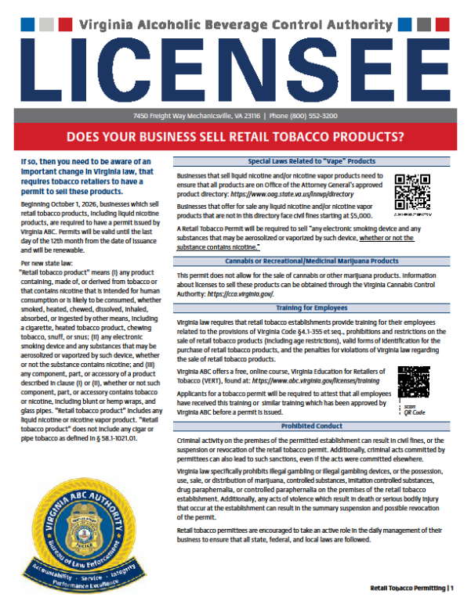
ABC BLE Efforts - Outreach Existing Licensees
Created a plan for streamlined process for existing licensees.
2-page document provided to existing licensees.
Outlines new process.
Full document can be found here:
https://www.abc.virginia.gov/licenses/tobacco-permits

Slide 9
Outreach and Education For Unlicensed Locations
Retailers without an ABC license will need additional guidance.
  VAABC developed a plan to address education, permitting, outreach, and illicit or illegal activity
  Plan considered different approaches for locations with an ABC license and locations without an ABC license (Tobacco/Cigarette shops, vape shops, other retailers)
  Our staff was provided training on all the new tobacco laws and proposed regulations. VAABC seeking voluntary compliance.

Slide 10
Permitting Efforts
Applications: (As of 09/15/26)
Cloned/Data Entered by LRM: 3042
(Existing ABC Alcohol Licenses where ABC has replicated pertinent information to transfer over to a tobacco permit)
Submitted online: 1818
In process online: 233
(applications not complete\ submitted)
Non-ABC license locations: 650
(applications received for non-licensees)

Slide 11
Outreach Efforts
1743 locations as of 09/15/26 have been visited for outreach. These are establishments who are not currently licensed by VA ABC.
Businesses identified by Agents who meet the definition of “Retail Tobacco Establishment”.
Information packets distributed to businesses.

Slide 12
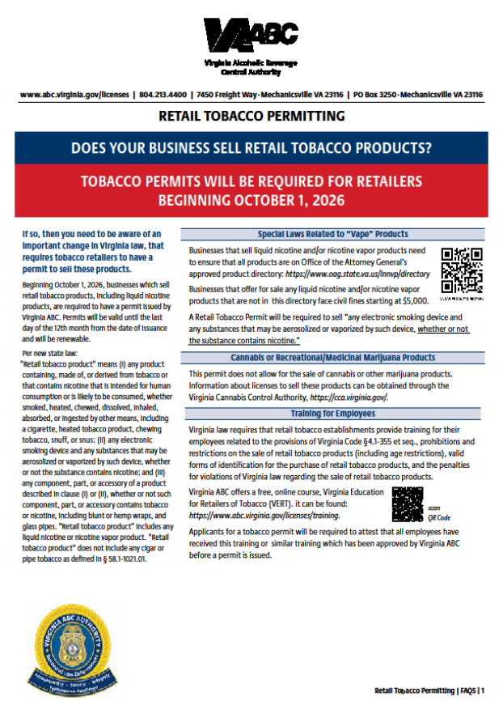
ABC BLE Efforts - Outreach
3-page document given to potential permitees by Agents.
Outlines new process.
Full document can be found here:
https://www.abc.virginia.gov/licenses/tobacco-permits

Slide 13
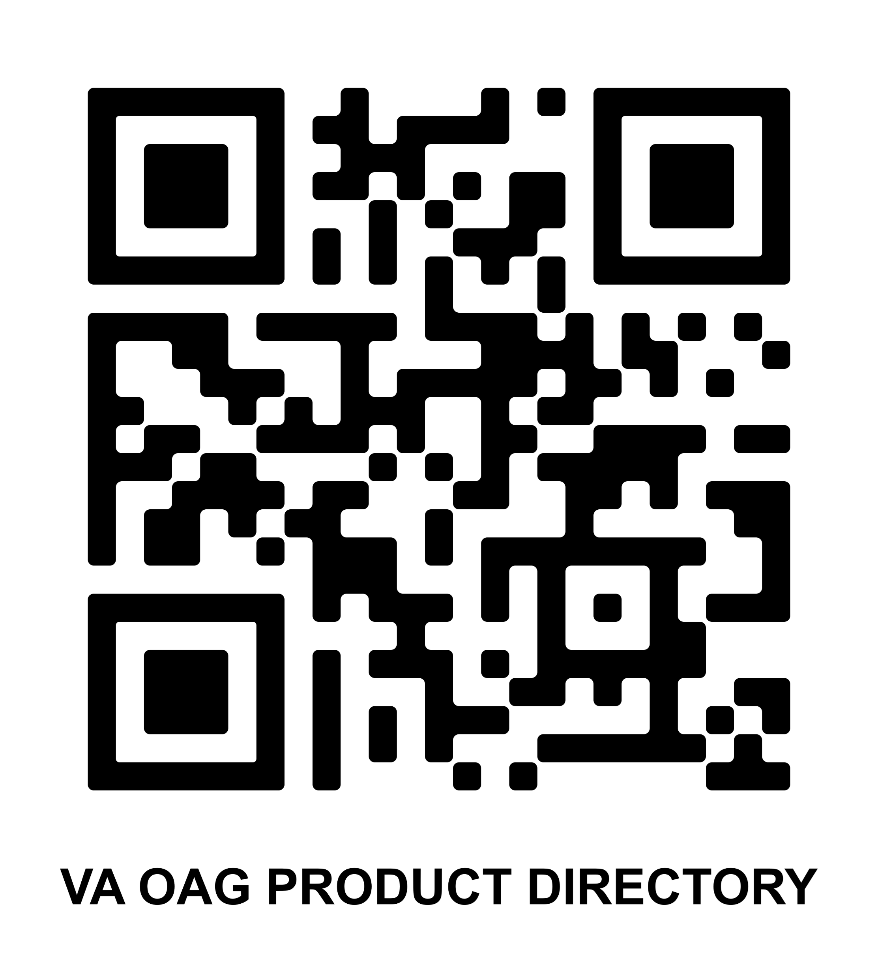
“Vape” Product Directory
Businesses that sell liquid nicotine and/or nicotine vapor products need to ensure that all products are on the Office of the Attorney General’s approved product directory: https://www.oag.state.va.us/lnnvp/directory
Approximately 185 unique SKU/UPC listed in
the directory.
Notes:
SKU/UPC will be the key to identifying products.
Link and/or QR Code to OAG directory will be printed on the permit certificates

Slide 14
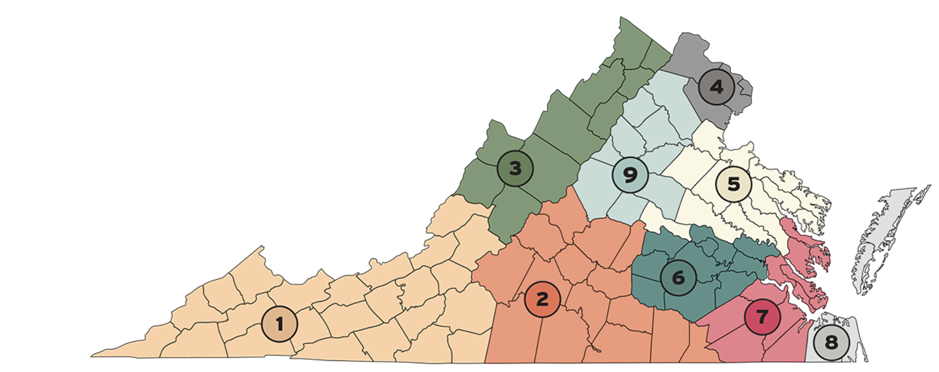
Breakdown of 1743 outreach visits
Region 1/2 387
Region 3/9 174
Region 4 363
Region 5/6 427
Region 7/8 391

Slide 15
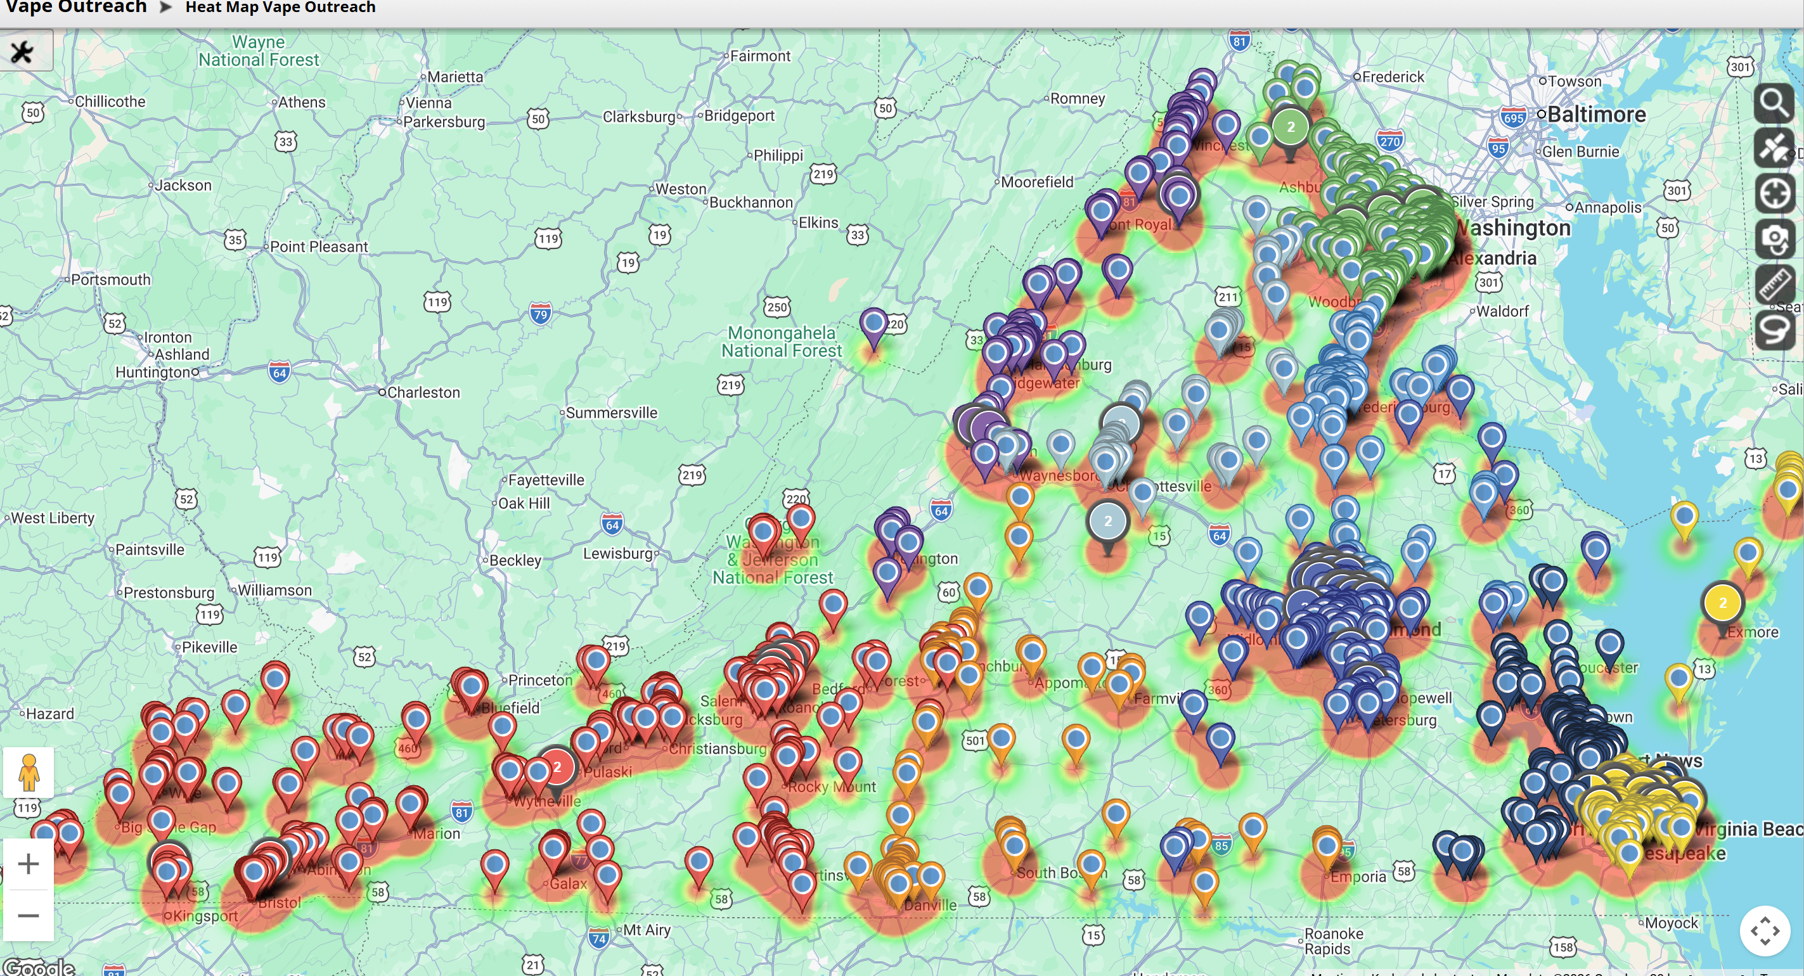
What does that equate to?

Slide 16
Next Steps
VAABC is working intensely to issue tobacco permits October 01, 2026.
Unpermitted/Unlicensed locations are being analyzed for additional outreach and investigation.
Evaluating Cease/Desist Order for locations that have not initiated the permitting process. (33% made application)

Slide 17
Questions?
Tom Kirby, ACEO
Thomas.kirby@VirginiaABC.com

